Slide 1
Computer Fundamental
1st Sem
Manas Kumar Ray
Department of Computer Application
B.B.College, Asansol

Slide 2
Information Processing System
DATA is a collection of independent and unorganized facts.
INFORMATION is the processed and organized data presented in a meaningful form.
DATA PROCESSING is the course of doing things in a sequence of steps.

Slide 3
Information Processing System
COMPUTER is an electronic machine that follows a set of instructions in order that it may be able to accept and gather data and transform these into information.

Slide 4
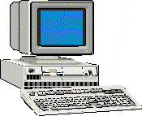
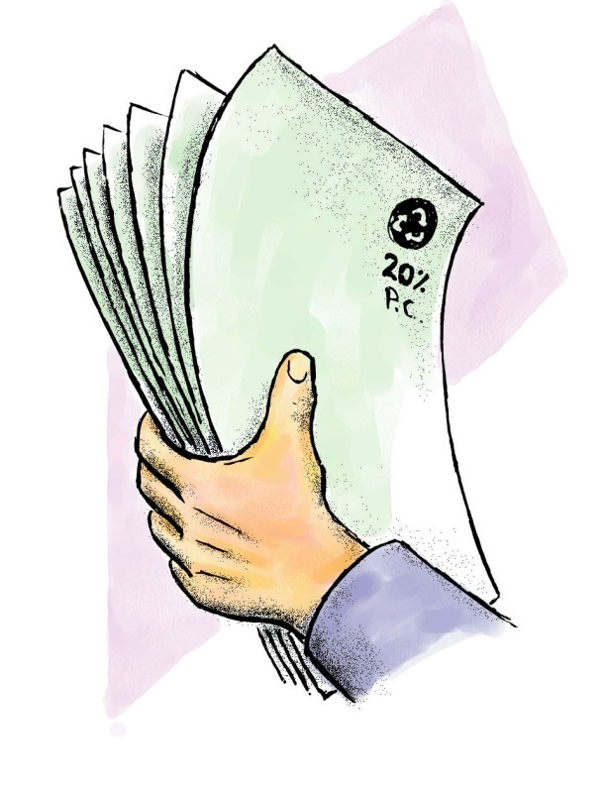
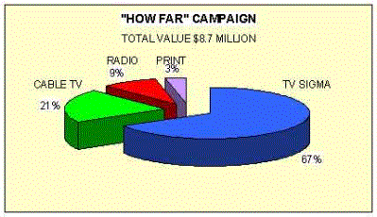
PROCESSING SYSTEM
DATA
INFORMATION

Slide 5
Functions of an Information Processing System
It accepts and gather data. (INPUT)
It processes data to become information. (PROCESSING)
It stores data and information. (STORE)
It presents information. (OUTPUT)

Slide 6
Three Major Components of an Information Processing System
HARDWARE is the tangible part of a computer system.
SOFTWARE is the non-tangible part that tells the computer how to do its job.
PEOPLEWARE refer to people who use and operate the computer system, write computer programs, and analyze and design the information system.

Slide 7
Basic Units of Measurement
BIT is a unit of information equivalent to the result of a choice between only 2 possible alternatives in the binary number system.
BYTE is a sequence of 8 bits (enough to represent one character of alphanumeric data) processed as a single unit for information.

Slide 8
Basic Units of Measurement
A byte can be used to represent a single character, which can be:
  A letter
  A number
  A special character or symbol, or
  A space

Slide 9
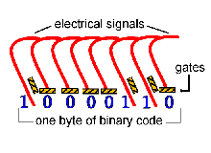
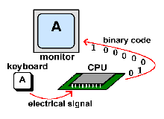

Slide 10
Basic Units of Measurement
1,000 bytes =1 kilobyte (K or KB)
1,000 KB =1 megabyte (MB)
1,000 MB =1 gigabyte (GB)
1,000 GB =1 Terabyte (TB)

Slide 11
BASIC PC HARDWARE
HARDWARE is the tangible part of a computer system.

Slide 12
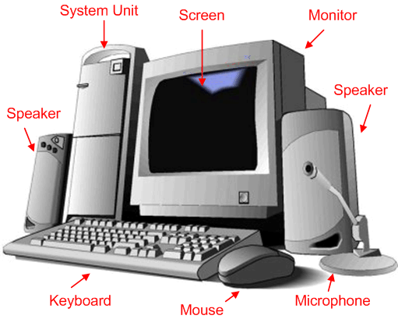

Slide 13
Basic hardware of a PC system
Central Processing Unit (CPU)
Memory Unit
Input Devices
Output Devices
Secondary Storage Devices

Slide 14
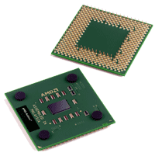
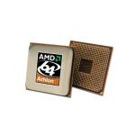
1. Central Processing Unit
Brain of the computer.
It directs and controls the entire computer system and performs all arithmetic and logical operations.

Slide 15
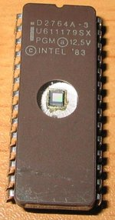
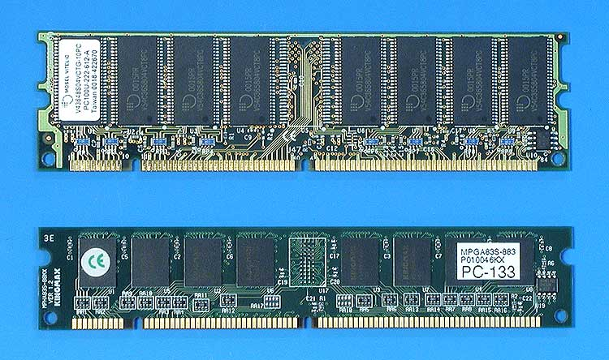
2. Memory Unit
Where the programs and data are stored .
  READ ONLY MEMORY (ROM) contains the pre-programmed computer instructions such as the Basic Input Output System (BIOS).
  RANDOM ACCESS MEMORY (RAM) is used to store the programs and data that you will run. Exists only when there is power.

Slide 16
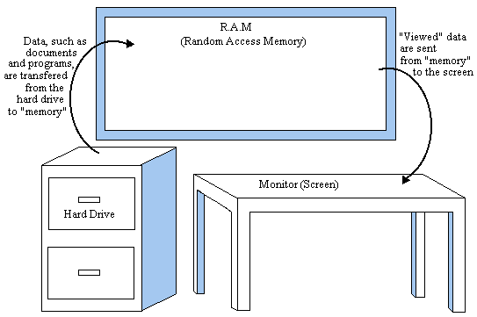

Slide 17
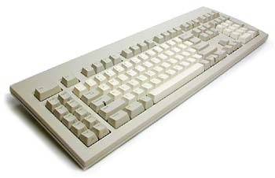
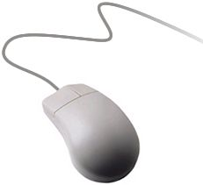
3. Input Devices
Allows data and programs to be sent to the CPU.
  Keyboard
  Mouse
  Joystick
  Microphone
  Webcam
  Scanner
  Monitor

Slide 18
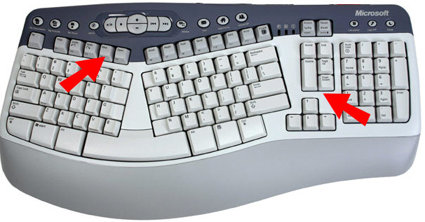
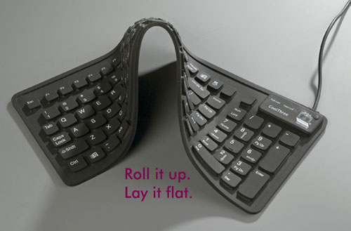
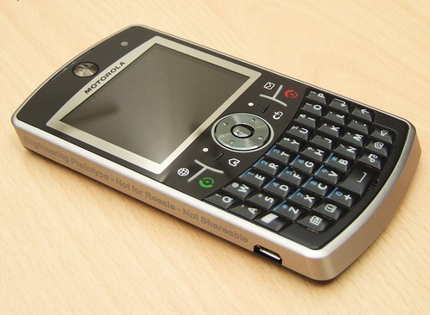
Keyboard
Traditional keyboards
Flexible keyboards
Ergonomic keyboards
Wireless keyboards
PDA keyboards

Slide 19
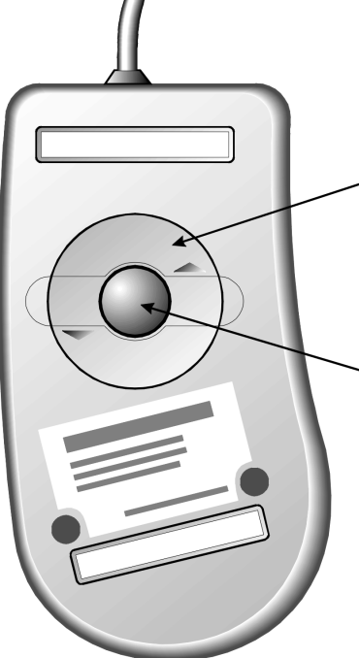
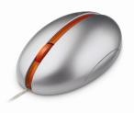
Two Types of Mouse
Mechanical - a type of computer mouse that has a rubber or metal ball on its underside and it can roll in every direction.
Optical: This type uses a laser for detecting the mouse's movement.

Slide 20
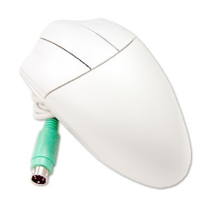
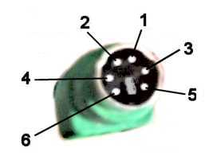
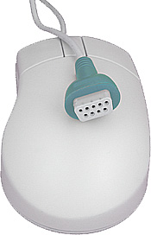
How a Mouse Hooks Up to a PC
PS/2 Mouse
Serial Mouse
USB/Cordless Mouse

Slide 21
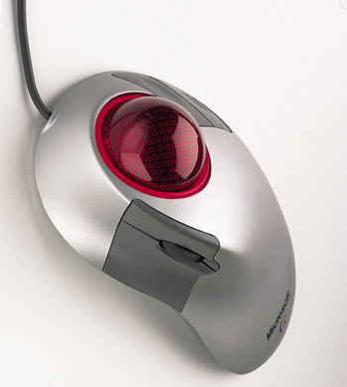

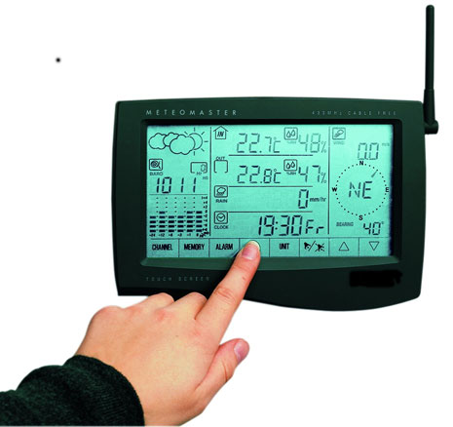

Other Pointing Devices
Trackball
Track point
Touch pad
Touch Screen

Slide 22
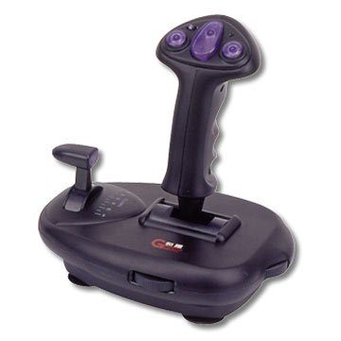
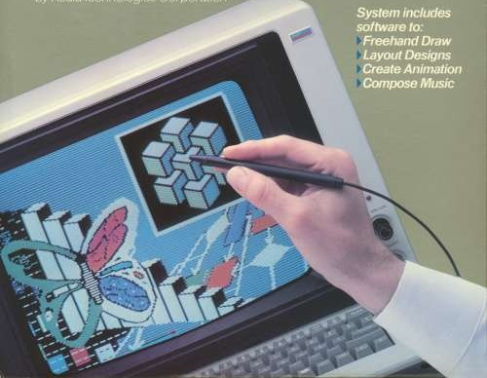
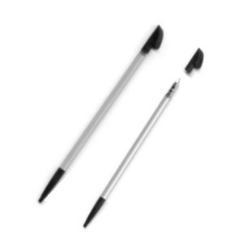
Joystick – input device for computer games
Light Pens – light-sensitive penlike device
Stylus – penlike device commonly used with tablet PCs and PDAs.

Slide 23
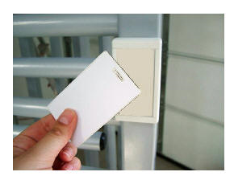
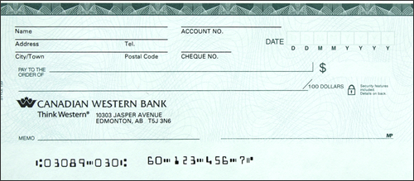
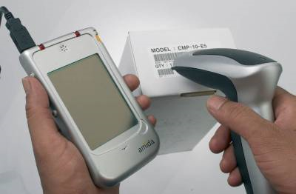
Scanning Devices
Optical scanners
Card readers
Bar code readers
Character and mark recognition devices

Slide 24
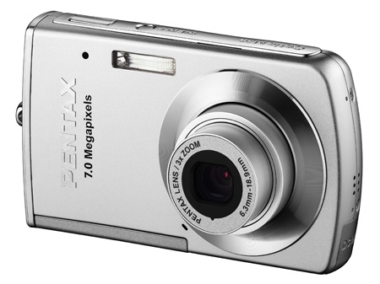
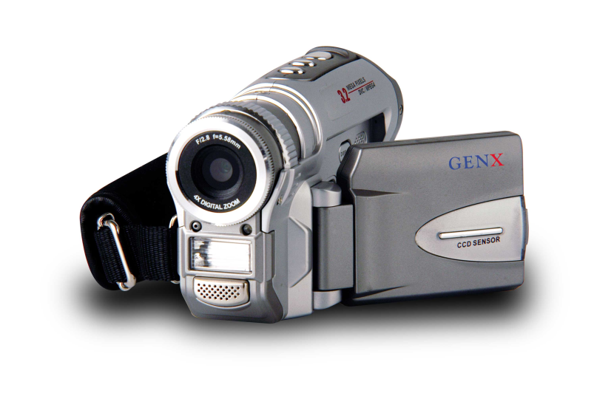
Image Capturing Devices
Digital Cameras
Digital Video Cameras

Slide 25
4. Output Devices
Media used by the computer in displaying its responses to our requests and instructions.
Monitor
Audio Speakers
Printer

Slide 26
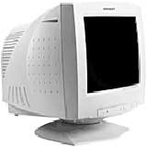
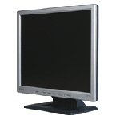
Types of Monitor
Cathode Ray Tube (CRT)
Liquid Crystal Display (LCD)

Slide 27
Printers
IMPACT PRINTERS uses pressure by physically striking the paper. Ex. Daisy wheel printers, line printers, dot matrix printers & band printers.
NON-IMPACT PRINTER does not apply pressure on the paper but instead produces character by using lasers, ink spray, photography or heat.

Slide 28
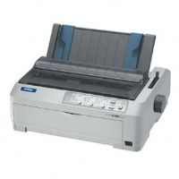
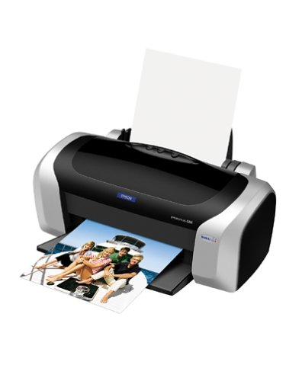
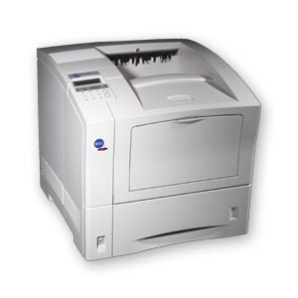
Dot matrix printer
Inkjet printer
Laser printer

Slide 29
5. Secondary Storage Devices
Attached to the computer system to allow you to store programs and data permanently for the purpose of retrieving them for future use.
Floppy disk, Hard disk, CD Rom

Slide 30
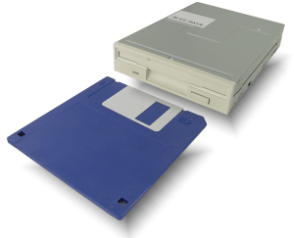
Floppy Disk
The most common secondary storage device
3.5” disk – 1.44MB

Slide 31
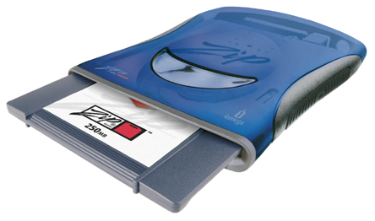
High-Capacity Floppy Disks
Floppy disk cartridges
3 ½ inches in diameter
Stores more information
Zip disks

Slide 32
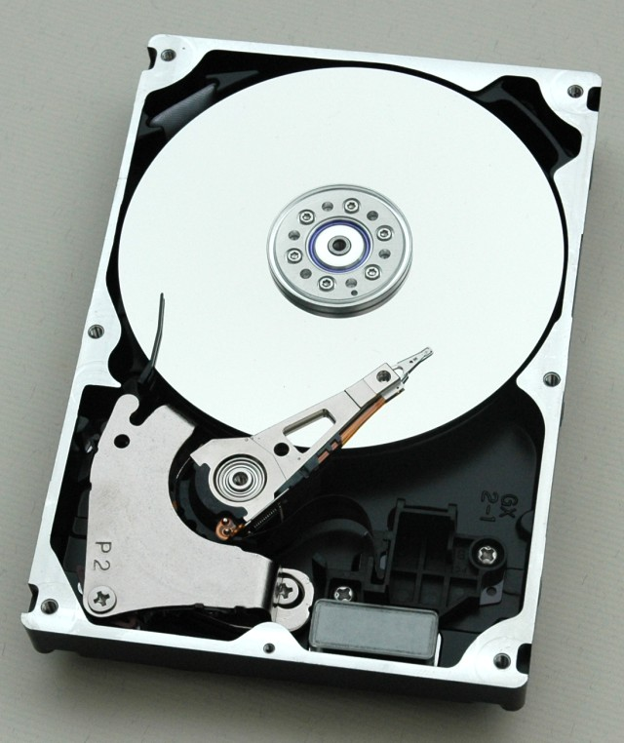
Hard Disk Drive or Hard Disk
Made of rigid materials unlike floppy disks
Holds a greater amount of data

Slide 33
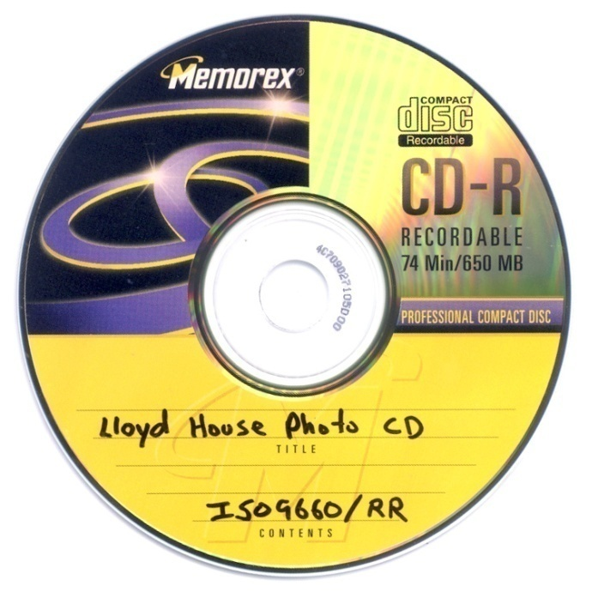
Optical Discs
A standard part of modern desktop machines, especially used for multimedia purposes and preferred in loading applications.

Slide 34
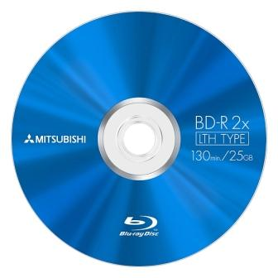
Kinds
Blue Ray Disk – 40G
Digital Versatile Disk
  DVD-R – write once, 3.95G
  DVD RW – rewritable, 3G
  Single Layer and Double Layer
Compact Disk
  CD-R – write once, 650MB
  CD-RW – rewritable, 700MB

Slide 35
Optical Drives
CD-ROM read CDs
CD-Writer read/write CDs
DVD-Combo read/write CDs, read DVD
DVD Writer read/write CDs
read/write DVDs

Slide 36
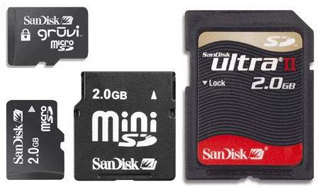
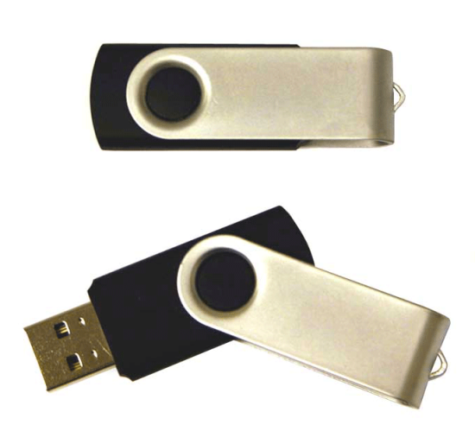
Other Secondary Storage
Solid-State Storage
  No moving parts
  Flash memory cards
  USB flash drives

Slide 37
Parts that Build Up A System Unit
Casing or cover
Power Supply
Motherboard
Microprocessor
Memory
Video Card
Sound card
Floppy disk drive
Hard disk drive
CD-ROM drive
MODEM

Slide 38
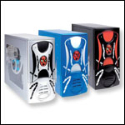
Casing or cover
The box or outer shell that houses most of the computer, it is usually one of the most overlooked parts of the PC.
Protects the computer circuits, cooling and system organization.

Slide 39
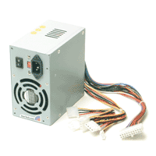
Power Supply
Responsible for powering every device in your computer.
Parts of a Power supply:
  Disk drive connectors
  Motherboard connector
  Power supply fan
  Power switch
  Input voltage selector
  Cover
  Power plugs receptacle

Slide 40
Motherboard
The physical arrangement in a computer that contains the computer’s basic circuitry and components.
Components are:
  Microprocessor
  (Optional) Coprocessors
  Memory
  Basic Input/Output System (BIOS)
  Expansion Slot
  Interconnecting circuitry

Slide 41
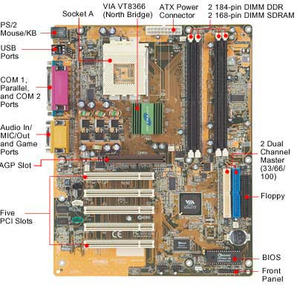

Slide 42
Expansion Slots
Graphic cards
Sound cards
Modem cards
Network interface cards/network adapter

Slide 43
Software
Instructions that tell the computer how to process data into the form you want.
Software and programs are interchangeable.
Two major types:
  System and Applications

Slide 44
2 Kinds of Software
1. System Software enables the application software to interact with the computer hardware.
  Operating Systems are programs that coordinate computer resources, provide an interface between users and the computer; and run applications.
  Utilities perform specific tasks related to managing computer resources.
  Device drivers are specialized programs designed to allow particular input or output devices to communicate with the rest of the computer system.

Slide 45
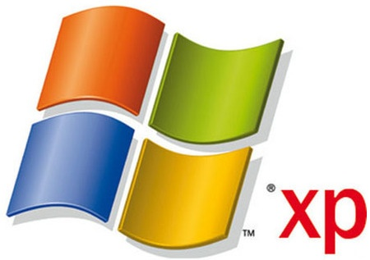
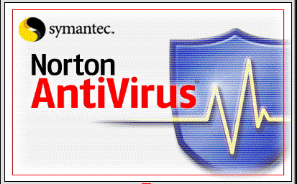
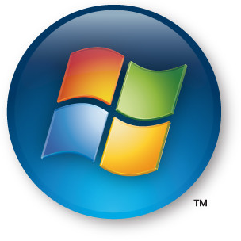
Functions of a System Software
Managing resources (memory, processing, storage, and devices like printer).
Providing user interface
Running applications

Slide 46


2 Kinds of Software
Applications Software - provides the real functionality of a computer. It help you use your computer to do specific types of work.
  Basic Applications, widely used in all career areas.
  Specialized Applications, more narrowly focused on specific disciplines and occupations.

Slide 47
DOS and GUI Operating System

Slide 48
Disk Operating System
DOS was the first widely installed operating system for personal computers.
Command-driven

Slide 49
MS-DOS Commands
A COMMAND is the name of a special program that makes your computer carry out a task.

Slide 50
Graphical User Interface (GUI)
Thru GUI, users can interact directly with the operating system.
Microsoft Windows
Icons, Menus, Dialog boxes

Slide 51
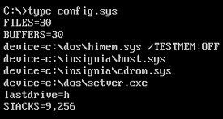


Slide 52
FILES
FILE is simply a collection of information that you store on a disk or diskette.
Must have a unique name
Two parts: the filename and extension separated by a period.
RECIPE.DOC

Slide 53
EXTENSIONS
Use extension to make your filenames more descriptive.
  .DOC – word documents
  .XLS – excel documents
  .PPT – powerpoint documents

Slide 54
DIRECTORIES
One way of organizing the files on your computer Hard Disk
ROOT – one basic directory
Subdirectories

Slide 55


